Slide 1

Jo Hanna
EME610
Dr. Malan-Rush
The University of Tampa
Spring 2024
in a corporate setting

Slide 2






History
1910s: Early examples of gamification appear such as Scouts using ranks and badges. In 1912, American Cracker Jack Popcorn started using prize rewards.
1930s: Businesses started using reward programs to incentivize repeat purchases.
1970s: The popularity of video games starts to rise.
1980s: Academic papers and research about the gamification of learning were being written and discussed.

Slide 3
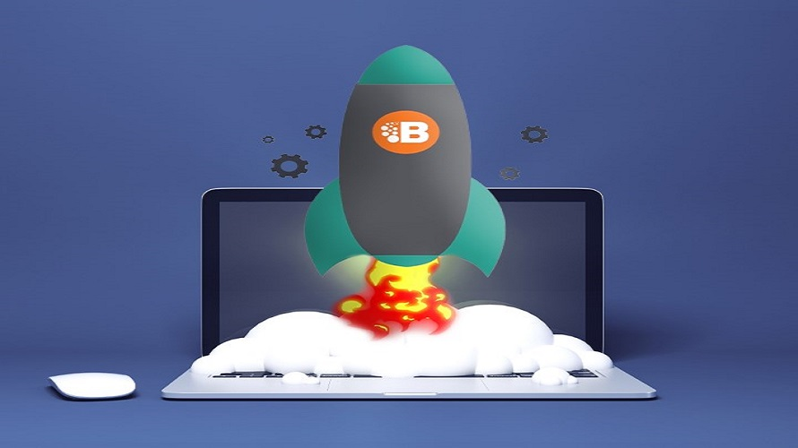
History
1990: Computers became more popular in the classroom. Games like MathBlaster were used but there was debate over how they tied into the curriculum.
2002: Serious games initiative was formed. SGI created serious games for the US military. This group powers most of gamification as we know it today.
2003: Conundra is the first gamification consulting firm.
2007: Bunchball the first gamification platform.

Slide 4
When did it become a trend?
2010: Coined and identified as a trend due to an increased interest in the internet.
2011: 400 attendees attend the 1st ever gamification summit in San Francisco. Additionally, gamification is added to the Oxford dictionary word of the year shortlist.
2011: Griffin (2014) states: “Corporate gamification really takes off. The success of gamified applications like Foursquare inspires many large corporates to jump on the gamification bandwagon.”
Today: Growth with usage, books, dedicated conferences, and continuous research.

Slide 5
Description
Gamification in a corporate setting adds elements of gameplay to onboarding and training goals within a company.
This trend is a multidimensional construct that enhances learning while incorporating new technologies and pedagogical approaches.
Yung (2020) researched six components:
  Team competition
  Goal-oriented challenges
  Clear rules
  Rapid feedback
  Integration with training goals
  Freedom to fail (opportunities)

Slide 6
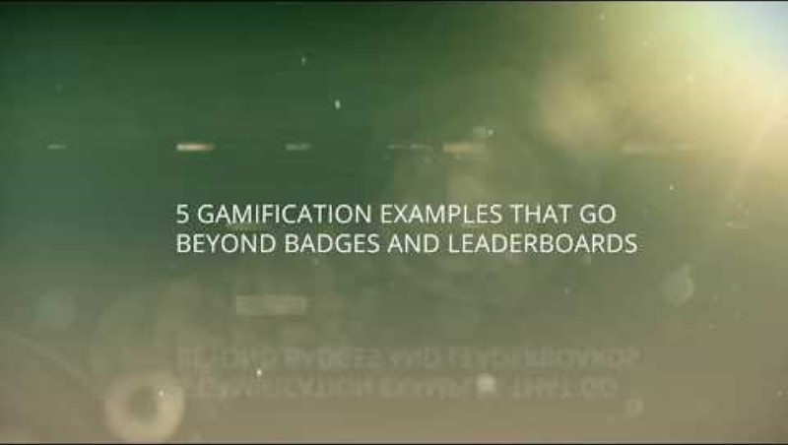
Description

Slide 7
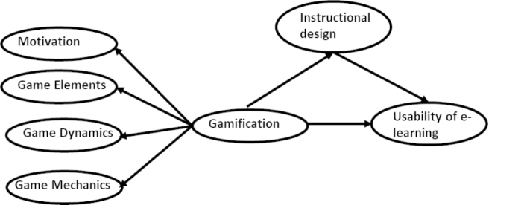
How has corporate gamification affected the field?
Gamification has aided the support of systematic instructional design methods.
This chart shows how these elements play into each other to support effective instruction.
Akanksha (2022) states “instructional design mediates the relationship between gamification and usability of eLearning among academicians.”

Slide 8
How has corporate gamification affected the field?
E-Learning
E-learning: Makes learning experiences more engaging, effective, and interactive. It allows for personalized learning paths and opportunities for mastery which is reflected when corporate uses gamification.
AI
AI: The affect on AI is seen by the allowance of personalized learning paths where AI can apply different algorithms like branching scenarios, quizzes and simulations. This creates a dynamic learning experience for employees.
Conclusion
Gamification in a corporate setting enhances learning by adding increased engagement and retention. Favorable interest has been shown regarding this topic and it has become a hot subject in the ID world especially due to recent tech advancements.

Slide 9


How has the field affected this trend?
Mobile learning:
Accessible platforms
Flexible scheduling
Leverages techniques to allow for bite sized content
Interactive due to touch screen and cameras
Promotes collaboration
Overall:
Mobile learning has made gamification more accessible and interactive for all learners.
Microlearning:
Targeted platform
Concise bite size material
Uses badges and points for short task
Immediate feedback
Connection with mobile eLearning
Overall:
Microlearning has made gamification flexible and appealing for all learners.
AI:
Personalization due to algorithms
Learning paths
Immediate feedback
Recommendations
Content curation
Overall:
AI has affected gamification in a positive way by allowing for a more personalized learning course.

Slide 10

Has gamification caused other trends or issues to arise?
Trends
Issues
Enhancement: Introducing game elements into corporate training materials leads to enhanced engagement.
Immersive technologies: AR and VR work hand in hand with gamification and have grown exponentially in recent years.
Overreliance: Gamification can be very motivating due to extrinsic rewards but for some, it can cause overreliance on gaming.
Superficial learning: Some jobs require hands on experience.
Fun versus educational balance: There is a time and a place for gamification to be beneficial.

Slide 11

Rebranding of Gamification
Name: EDprofession
Introduces a more professional aspect to traditional gamification.
Focuses on classic business centric terminology and visuals.
Aligns learning with outcomes in a professional setting.
Incorporates the positive impacts of this trend while minimizing its known opportunities.
Promotes employee motivation.
Improves skill development.

Slide 12
Rebranding of Gamification
The goal of this rebranded tool is to incorporate gamification into the professional and corporate field. The aim is to drive adaptability among employees and incorporate interactive learning journeys within the company by communicating its importance and framing it in a way that resonates with employees, management, stakeholders and the company.
Motivation: Employees may be motivated to participate if the company offers rewards, promotions or just to familiarize themselves in the field without having to participate in a multiday onboarding process.

Slide 13
Rebranding of Gamification
Digital campaigns: These campaigns are for the target audience and are done using social media such as LinkedIn and X.
Conferences or webinars: Another way to demonstrate how this trend is applicable within the corporate environment.
Partnerships: EDprofession partners with LMS vendors and HR software companies to promote gamification.
Corporate training events: Catered to execs, training managers and HR to experience how the demos work.
Research reports: These reports relay the tools effectiveness and demonstrate innovative approaches within the field of instructional design.

Slide 14

Reason 1
I am interested in pursuing the corporate field after graduation and I am really enjoying my games and simulations class, so this topic was the perfect combination.

Slide 15
Reason 2
Gamification is easily associated with children and learning, but I am interested to see the growth in this field and how it can be applicable to adult learners/employees as well while still being engaging.

Slide 16

Proposed Strategy
Alignment with corporate goals: A company should make sure the goals and objectives are clear and that the gamified learning is catered to those goals. These can include training goals, skill development, productivity and customer satisfaction.
Investments for technology: As new technology emerges; the company needs to be willing to invest where possible to provide up to date training.

Slide 17
Proposed Strategy
Training and development: The instructional designers should be adaptable and stay up to date with trends. Gamification is always evolving, and new research is constantly being produced.
Continuous improvement: It is important to regularly evaluate and assess employees to potentially identify an opportunity for growth. Gamified learning provides this feedback and scoring but it is also important to keep in mind new technologies or devices.

Slide 18
Proposed Strategy
Integration with learning strategies: Apply gamification to problem-based learning, make it collaborative and create different scenarios are all ways to integrate learning strategies into corporate gamification. This helps make it engaging.
Leadership support: The support of management and stakeholders is integral to the success of gamification in a corporate setting.

Slide 19
Proposed Strategy
Data driven decisions: Data should be evaluated and discussed with stakeholders to fine tune training and to effectively develop it more.
Promotion and recognition: When a company uses promotion and recognition, it can keep employees motivated which improves retention and the drive to keep learning.

Slide 20
Conclusion
References
Akanksha, G., & Urvashi, T. (2022, August 15). Integrating gamification and instructional design to enhance usability of online learning. PubMed Central, 28(2), 2187-2206. Integrating gamification and instructional design to enhance usability of online learning - PMC (nih.gov)
EI powered by MPS. (2017, February 8). Go beyond badges and leaderboards - 5 examples of gamification in corporate training [Video]. YouTube. https://www.youtube.com/watch?v=bzoOrYmWaEM
Griffin, D. (2014, March 25). A brief history of gamification. The HRdirector. A brief history of Gamification | theHRD (thehrdirector.com)
Larson, K. (2020, March 1). Serious games and gamification in the corporate training environment: a literature review. TechTrends, 64, 319-328. https://doi.org/10.1007/s11528-019-00446-7
Yung-Fu W., Ya-Fang, H., & Kwoting, F. (2020, May 29). The key elements of gamification in corporate training – The Delphi method. Entertainment Computing, 40. https://doi-org.esearch.ut.edu/10.1016/j.entcom.2021.100463
PDF link for references: 610 References.pdf
Thank you for watching. I hope you enjoyed learning about gamification in a corporate setting!

