Slide 1

Theory Presentation
Jo Hanna
University of Tampa
EME 602-1 Theories of Learning and Cognition for Instruction
Dr. Rush
10/27/2023
Notes:
Line spacing + Page numbers

Slide 2
Background
Developed by Robert M. Gagne.
His conditions for learning were developed in 1965.
He worked closely with Briggs.
Instructional theory is defined as identifying the methods that will best provide the conditions under which learning goals will most likely be attained (Driscoll, 2004, p. 352).
His nine events should be used beside Blooms Taxonomy to create classroom instruction.
(Driscoll, 2004, p349-383)
1

Slide 3
Background
There are four components that teachers should use when developing instruction.
  The learner
  The learning task
  The learning environment
  The frame of reference
(Driscoll, 2004, p349-383)
2

Slide 4
Background
Gagne produced five categories for learning outcomes:
  Verbal Information
  Intellectual skills
  Cognitive strategies
  Attitudes
  Motor skills
This theory continuously influences the field of EdTech.
This theory is based on levels of learning.
(Driscoll, 2004, p349-383)
3

Slide 5


Assumptions about learners
Assumptions
Verbal information:
The instructors should present information in meaningful chunks, so the learner avoids information overload.
Learners memorize information without regard to the meaning of it.
This taxonomy is completely undetectable based solely on observation.
A student must know letters before they can write anything.
Objectives may limit the learning but can also work to support learners.
(Driscoll, 2004, p349-383)
4

Slide 6


Assumptions about learners
Assumptions
Cognitive strategies:
Employed to monitor own knowledge and encode.
Learners generate their own problems.
Describe or demonstrate the strategy.
Intellectual skills:
Set up in a hierarchy.
Students must be able to distinguish squares from other shapes before they can explain the characteristics of a square.
(Driscoll, 2004, p349-383)
5

Slide 7


Assumptions about learners
Assumptions
Motor skills:
Different outcomes call for different learning conditions.
Learners will achieve with repeated practice.
Learners need immediate feedback.
Attitudes:
The information about an attitude should be known in order for them to respond in a particular way.
A good attitude enhances learning.
(Driscoll, 2004, p349-383)
6

Slide 8
Instructional principles
The goal of instruction is that the instructor works as a facilitator for activation.
Each event supports an internal process.
1. Gaining attention: Occurs via a stimulus change. This is an important first step. There are many tactics one can use to get attention.
2. Informing the learner of the objective: Expectations develop at all ages. Therefore, using clear expectancies allow the learners to be aware of what is happening.
3. Stimulating recall of prior knowledge: The instructor is responsible for assisting in recalling relevant information to activate prior knowledge.
(Driscoll, 2004, p349-383)
7

Slide 9
Instructional principles
4. Presenting the stimulus: This differs based on the learning goal (information acquisition, intellectual skill learning, motor skills or attitude learning). The instruction should have the essential features to meet the learning goals.
5. Providing learning guidance: This applies less during discovery learning. The aim is to move learning into LTM and this is done by instructional support. Use of hints or cues.
6. Eliciting performance: The goal of this is to have the learners demonstrate what they learned in a penalty free environment.
(Driscoll, 2004, p349-383)
8

Slide 10
Instructional principles
7. Providing feedback: Students should always be provided with feedback that lets them know what is right and wrong. If wrong, the instructor should provide guidance on how to correct their answers.
8. Assessing performance: A formal assessment is needed to assure the learning goal has been met. This can be done with a test or portfolio.
9. Enhancing retention and transfer: Often this is built in during previous steps. Attention learning has special requirements stressed on retention and enhancement.
(Driscoll, 2004, p349-383)
9

Slide 11

With the interest growing around constructivism, theorists have started to question Gagne and wondered if this theory is compatible with the assumptions and goals of constructivist epistemology.
Other views
(Driscoll, 2004, p349-383)
10

Slide 12
Comparison of Gagne vs. Constructivism
Gagne’s theory and constructivism are closely related verse other theories.
Learning is driven by problem solving and memory.
Both discuss learning goals.
Both theories are not suitable for all learners.
(Driscoll, 2004, p349-383)
11

Slide 13
Comparison of Gagne vs. Behaviorism
These are opposing theories.
Behaviorism deals with operant behavior and reinforcers. The instructor creates an environment to provoke a certain response.
Common overlaps are mentions of long-term memory and that they are both based on models.
(Driscoll, 2004, p349-383)
12

Slide 14
Why I chose this theory
I chose this theory because I have a background in education, and this is often applied in the classroom. Of all the theories, I think this is one I will use often after graduation. This chapter was engaging to me while reading it and I really enjoyed learning about Gagne.
(Driscoll, 2004, p349-383)
13

Slide 15
Assessment
Assessment
The best way to assess this theory is by planning instruction with the 9 steps in mind.
When assessing during instruction, it is best to use summative assessment such as test for the chapter or use portfolios.
(Driscoll, 2004, p349-383)
14

Slide 16
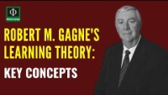
Video Resource
(Robert Gagne’s Learning Theory, 2020)
15

Slide 17
My lesson: Comic books
Now that I have briefed you on my chosen theory, we will participate in an activity together.
This lesson is on comic books and is based on the nine steps.
1
2
3
4
5
6
7
8
9
Informing the learner of the objective
Presenting the stimulus
Eliciting performance
Assessing performance
Stimulating recall of prior learning
Providing Feedback
Providing learning guidance
Enhancing retention and transfer
Gaining Attention
(Driscoll, 2004, p349-383)
16

Slide 18

This video aligns with step one and serves as the attention grabber. See if you can follow along with the steps through the rest of the lesson.
(bauer, 2012)
17

Slide 19
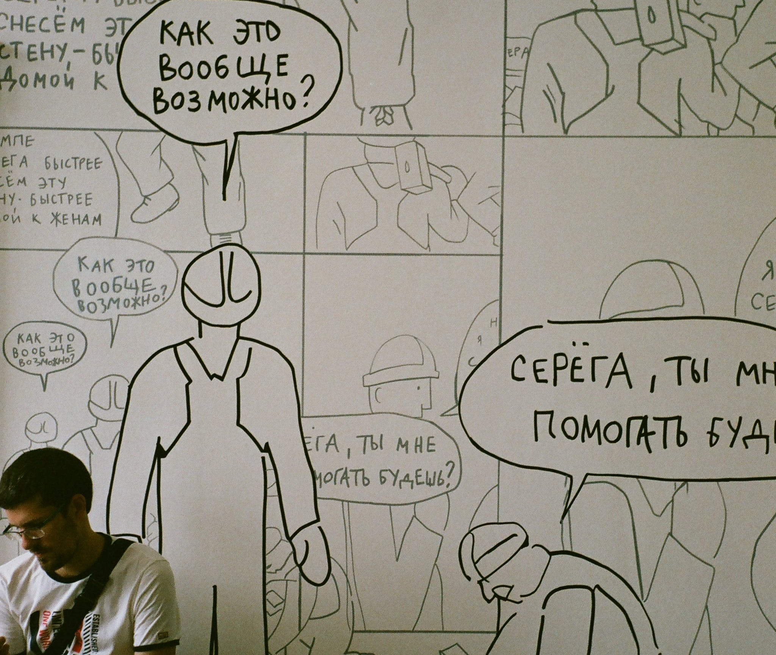
The objectives of this lesson:
The student will have created a comic book
The student can describe how to craft a narrative and use onomatopoeia successfully
18

Slide 20
Discussion Questions
Do you like comics? Which ones?
Has anyone played a video game or watched a show based on a comic book?
Do you think comic books are easier to read than regular books?
19

Slide 21
Character
Setting
A character performs in the story and speaks the dialogue.
Things to think about:
What is their name?
What personality does she/he have?
What type of events will this character be involved in?
The setting is where and when the story takes place.
Things to think about:
Where does this story take place?
20

Slide 22
Onomatopoeia
Art tips and reminders
An onomatopoeia is a word that sounds like what it refers to or describes.
Include at least on in your comic.
Examples:
  -boom
  -smash
  -haha
  -bang
  -crash
Do not rush, it shows.
If you mess it up, dress it up.
Use of a pencil is a great starting point then color after.
I am providing a brainstorming sheet to use as a rough draft if you want.
Don’t yuck someone's yum.
Always do your best.
21

Slide 23
The project
You will now work independently to create a comic book. Please keep in mind that you should incorporate the elements of a character, a setting, a story and an onomatopoeia.
You will be graded on use of these elements, effort and creativity.
I will pass out the materials and set the timer.
Review of onomatopoeia
Together we will make the format, I will lead on the board, and you will follow along.
22

Slide 24
Next steps
Switch paper with a partner and fill out the feedback sheet.
Then you will return the feedback sheet to the author.
Once you receive your feedback sheet, please staple them together and turn them in.
The rubric has been posted on the board for reference if you want to know how you will be graded.
23

Slide 25

Final Step: Enhancing transfer
In the real world, this class has a blog. All art projects, including this lesson on comic books, get scanned and uploaded to the blog so students can refer to their work, see what their peers have done, and this also allows family and friends to acknowledge what great work is being done in class.
24

Slide 26

Closing
I chose to present in a way that clearly demonstrated the nine steps in Gagne’s theory and that fit within the limitations of this classroom dynamic.
Thank you for coming to my presentation.
Citations:
Driscoll, M. (2004). Psychology of learning for instruction (3rd ed., pp. 349-383). Boston, MA: Pearson.
25

