Slide 1
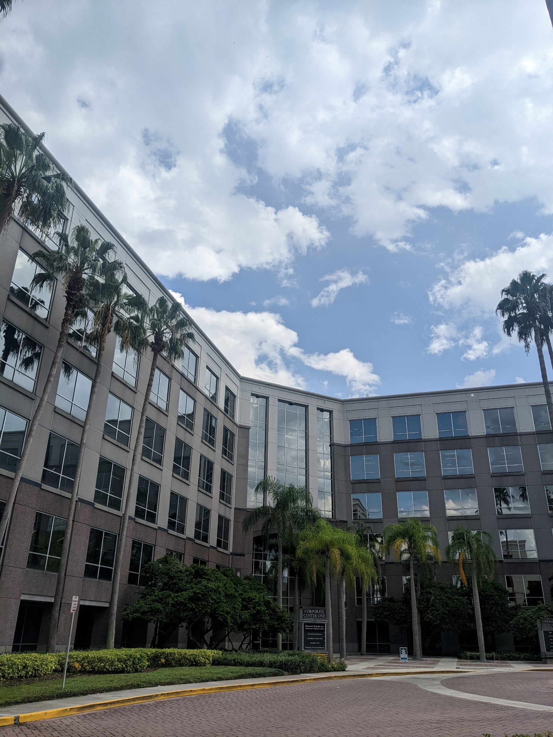
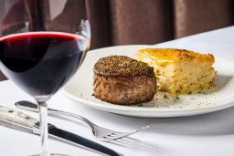

Internship Presentation
Jo Hanna
Summer 2024

Slide 2
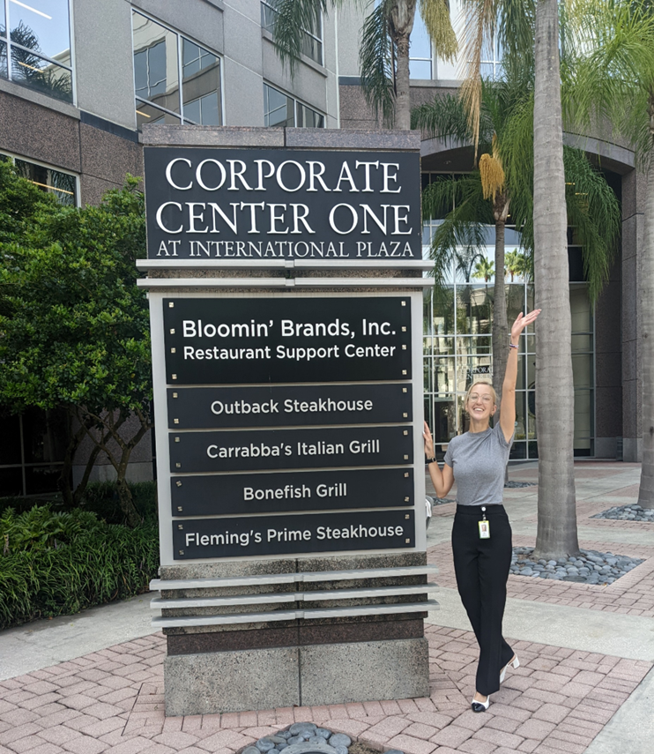
About Me
Hometown: Tampa, FL
School: The University of Tampa
Major: Instructional Design and Technology
Role: Instructional Design Intern at Fleming’s

Slide 3



At the start of my internship, I set goals for what I wanted to improve on both professionally and personally.
My Goals
Goal # 1
Goal # 2
Goal # 3
To work collaboratively on a project during my internship.
To develop and enhance my skills using Articulate360.
To get comfortable with public speaking by taking opportunities that are presented to me.

Slide 4
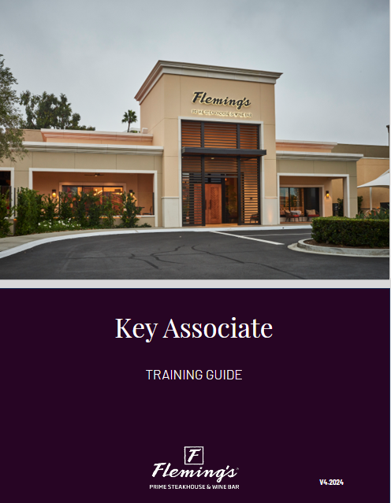
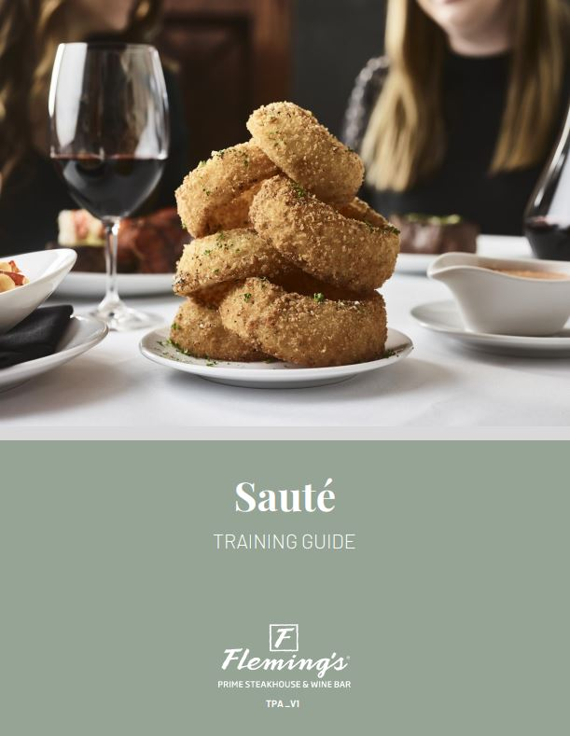
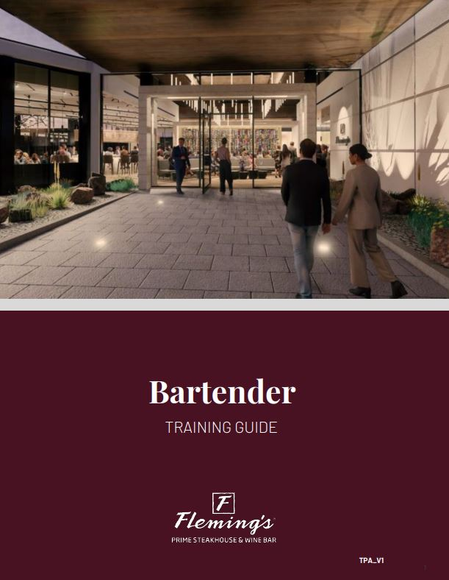
My Projects
Aligned WIT Standards to training material to keep it updated and uniform across the field.
I have highlighted a series of impactful projects that I had a hand in while here at Bloomin’ Brands. These projects encompass a range of skills that I was able to develop during this journey. Each project has allowed me to grow as an Instructional Designer and enhanced my learning experience.
Reviewed and edited training manuals for the new Tampa flagship restaurant.
Created facilitator guides for the new Tampa flagship restaurant.
Provided edits and insight to enhance the Key Associate program and the Food & Beverage Guide among other smaller projects.
Helped develop Associate training schedule and activities for the restaurant opening.

Slide 5
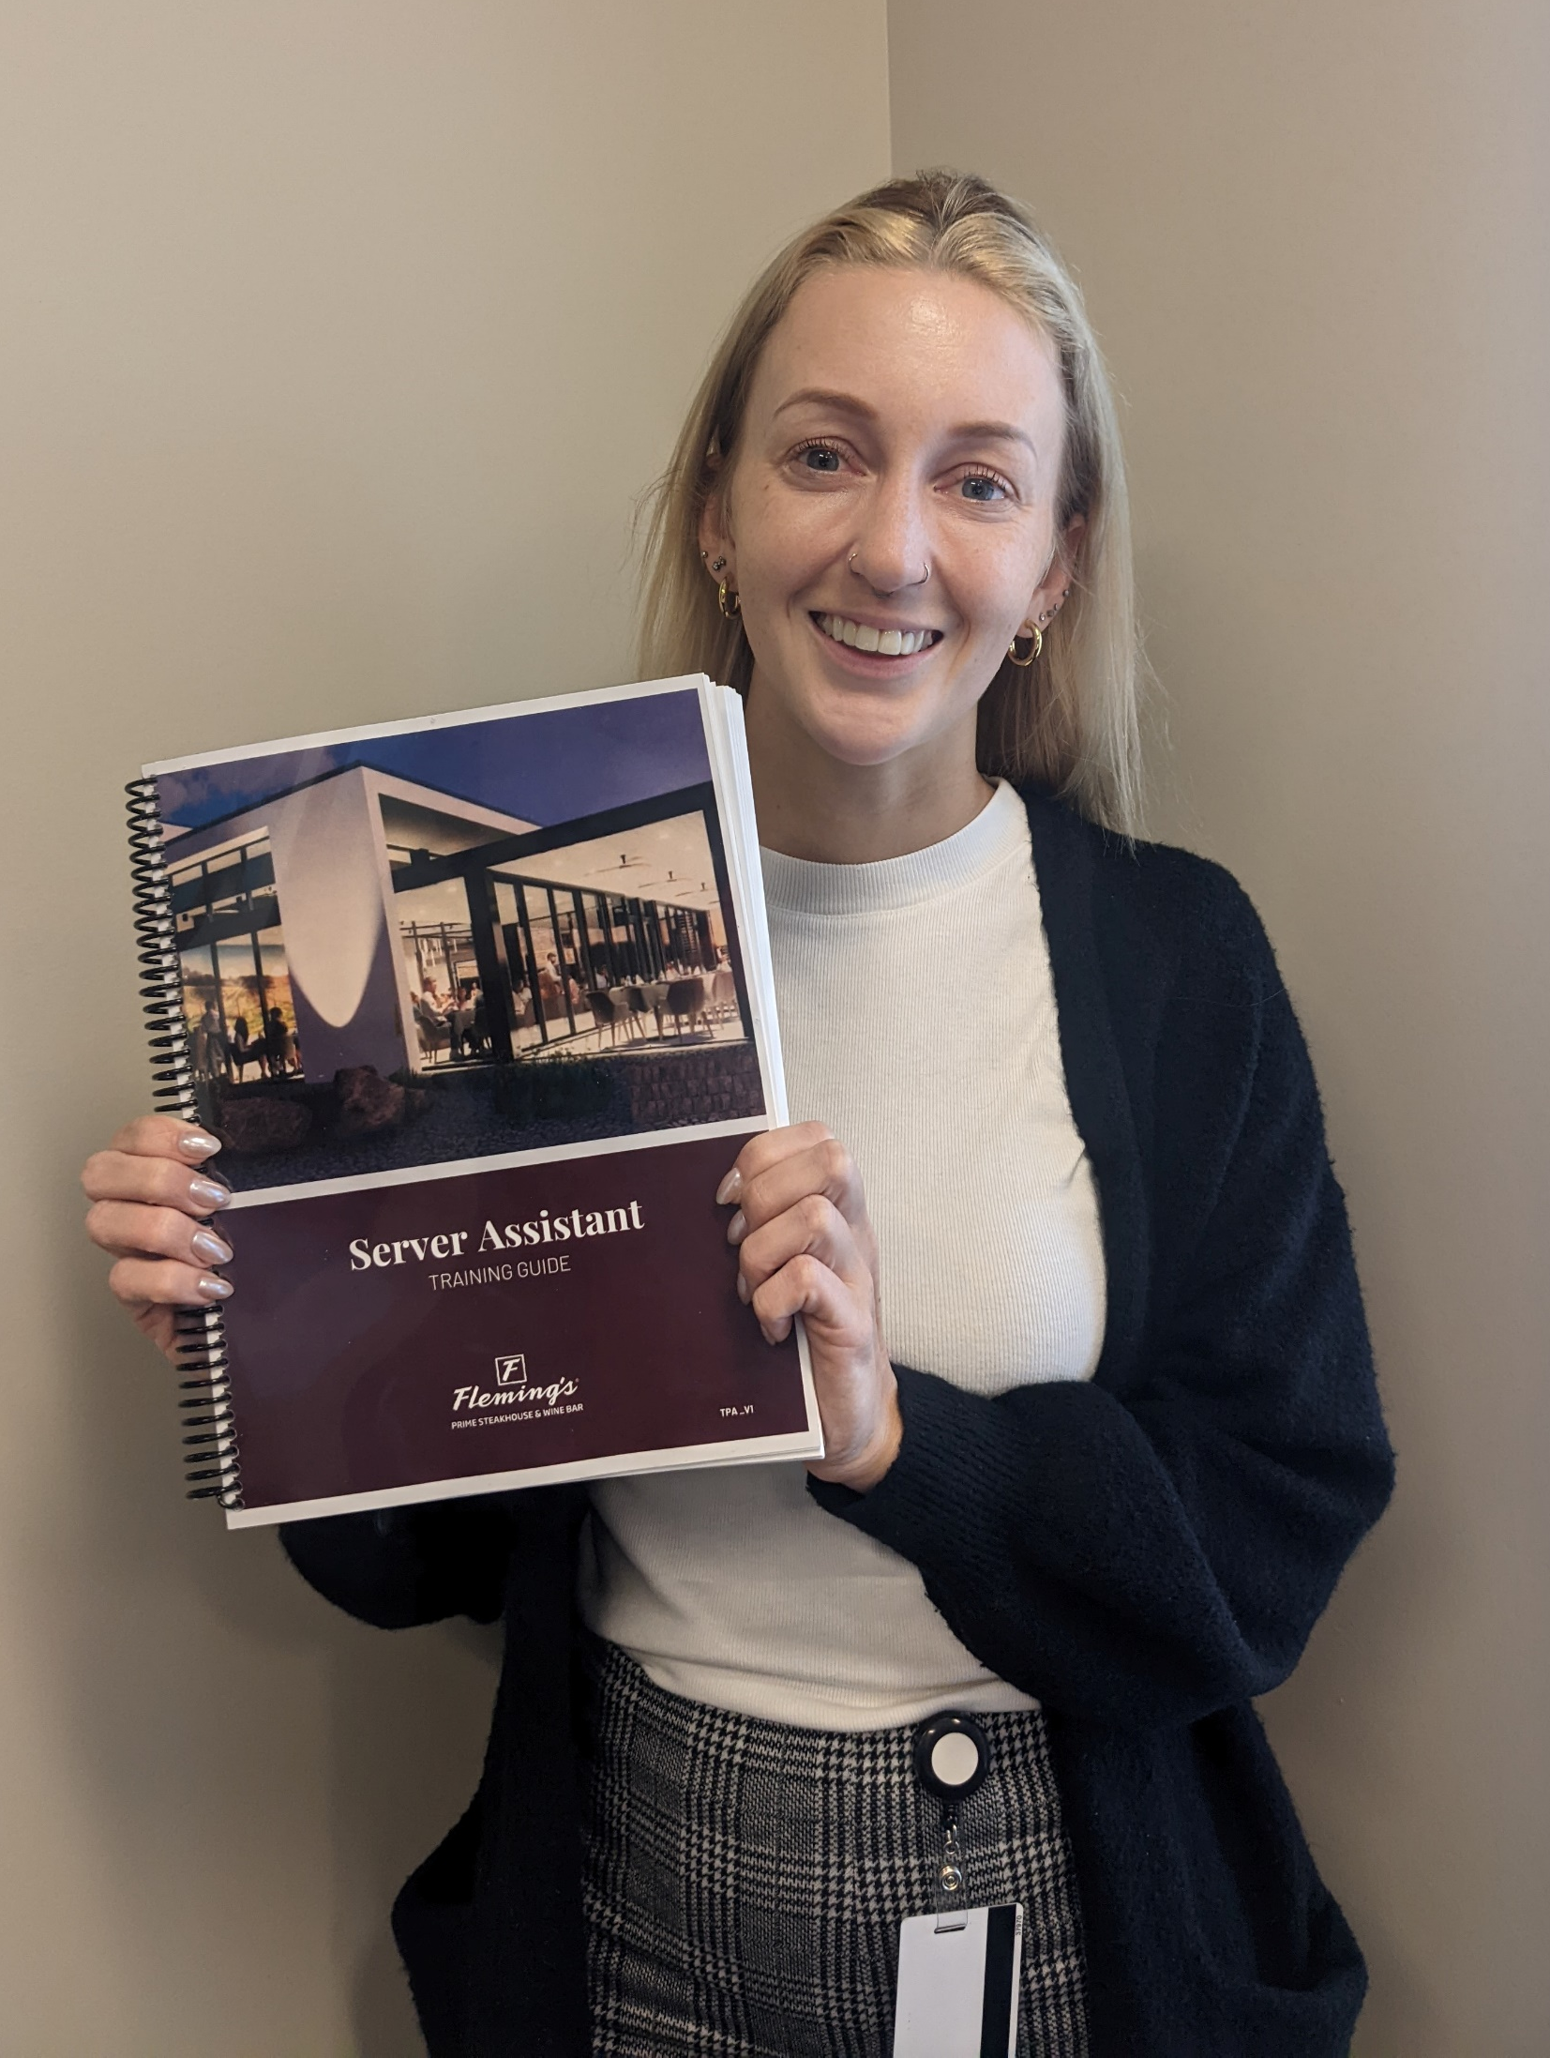
How did my projects and goals align?
Real World Application
Skill Development
Collaboration
Portfolio Building
Understanding Company Needs

Slide 6
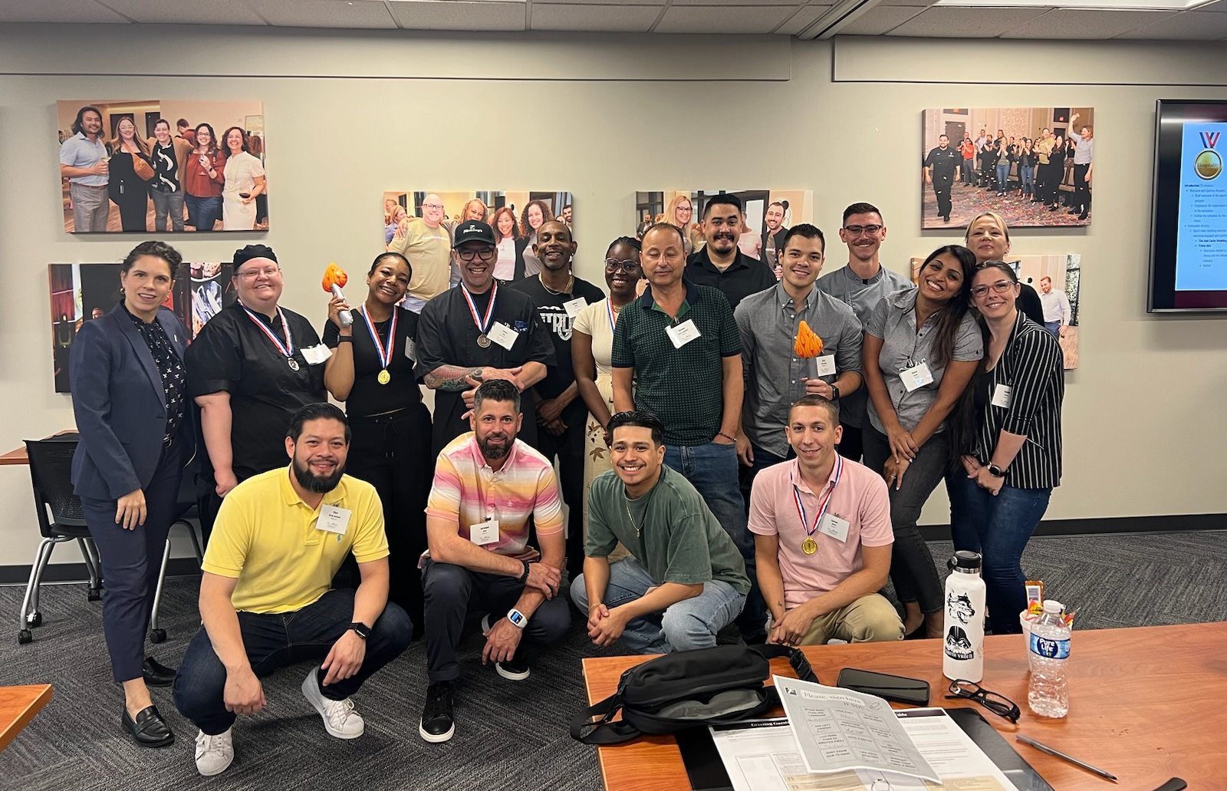
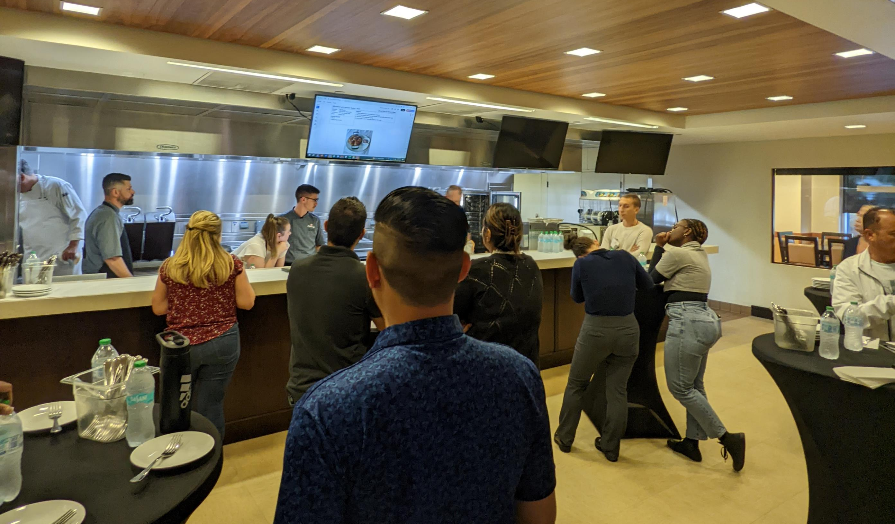
Train the Trainer Week
July 28th- August 3rd
An opportunity for me to see what it is like once training material goes out to the field. This group of Associates spent a week here at the RSC before heading to the new restaurant to train our Associates and implement that elevated service we aim for.
They are an integral part of this opening, and I have thoroughly enjoyed meeting everyone and seeing the training schedule roll out knowing that I got to have this intern experience during it.

Slide 7
Professional Development
Principles and Beliefs
Excellence | This was reflected in the way the team strategized various opportunities for enhanced training and growth with the new Tampa restaurant.
Respect | I experienced this P&B in the way that my team treated me. They included me like I was a co-worker, leaned on me for opinions, and invited me to eat lunch with them daily.
Hospitality | This Fleming’s P&B is seen all throughout the building. Everyone is so friendly and hospitable. The attitude and the environment are very enjoyable.
There were several areas where I developed professionally from this internship. Bloomin’ Brands provided great networking opportunities and ways to connect with colleagues. I enhanced my instructional design skills that will apply to any future pursuits. Additionally, I gained confidence in my work. I had a wonderful supervisor who helped guide me and really allowed me to take control of my work so I could learn and grow.

Slide 8
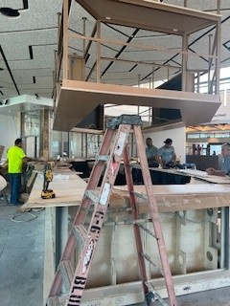
Contributions
I was able to contribute to BBI and Fleming’s this summer in a multitude of ways.
Provided valuable support to my team while they worked diligently to develop training materials and schedules for our new Tampa flagship restaurant.
Brought a fresh perspective and suggested some new ideas pulled from my education background.
Provided support on projects especially as deadlines approached regarding a new restaurant opening.
Discussed suggestions with Lauren and the other interns as part of a feedback loop that can help the internship program here at BBI.
Back t Agenda

Slide 9
Involvement in BBI
Bloomin’ Buddy
Intern Lunches
Chef Day
Wine Down Wednesday
I was partnered with Billy Otto. He was extremely helpful and inviting. With him, I was able to experience Carrabba's filming and their wine dinner.
During our weeks here, I was able to set up weekly lunches that allowed us to connect and form personal relationships.
I was able to register for Chef day which I found to be extremely valuable and such a fun experience.
I was able to attend Wine Down Wednesday where I could connect with members of other departments and hear about upcoming projects for other brands.

Slide 10

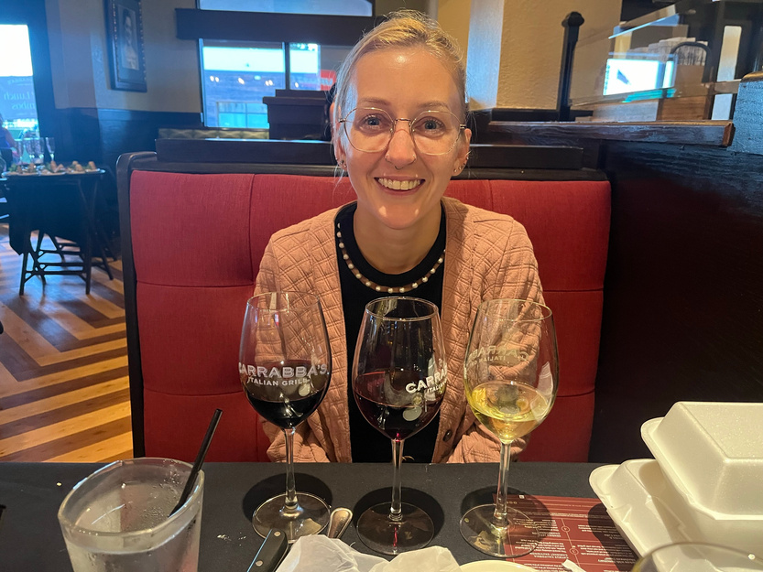
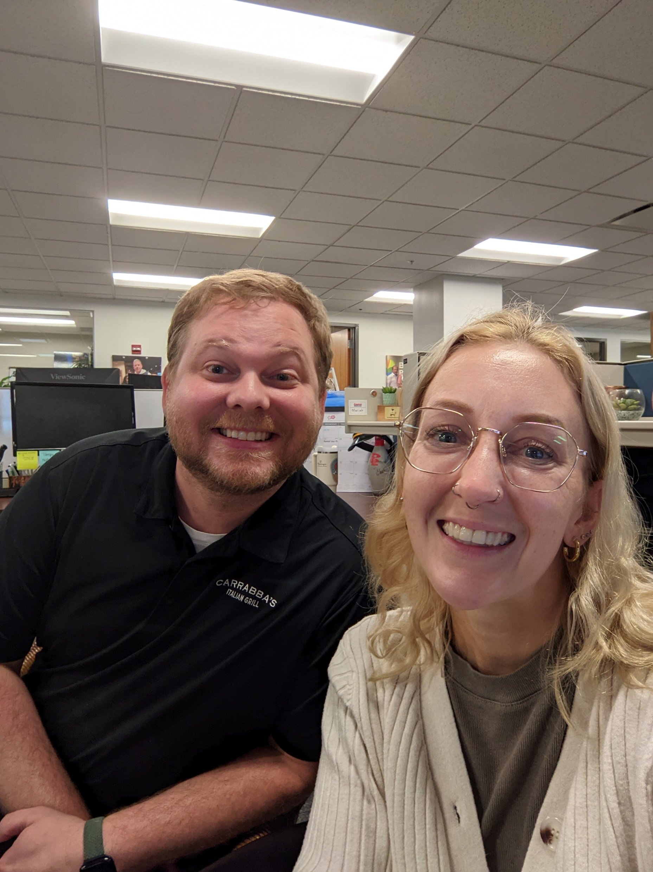
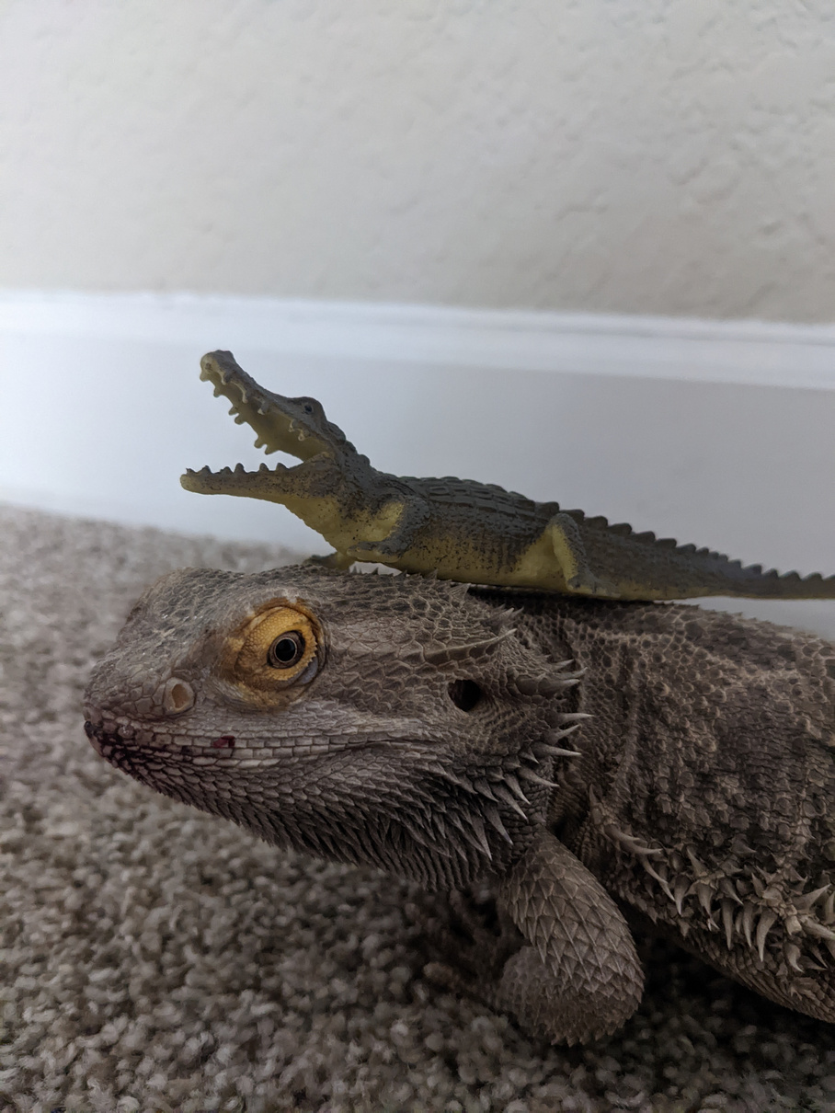
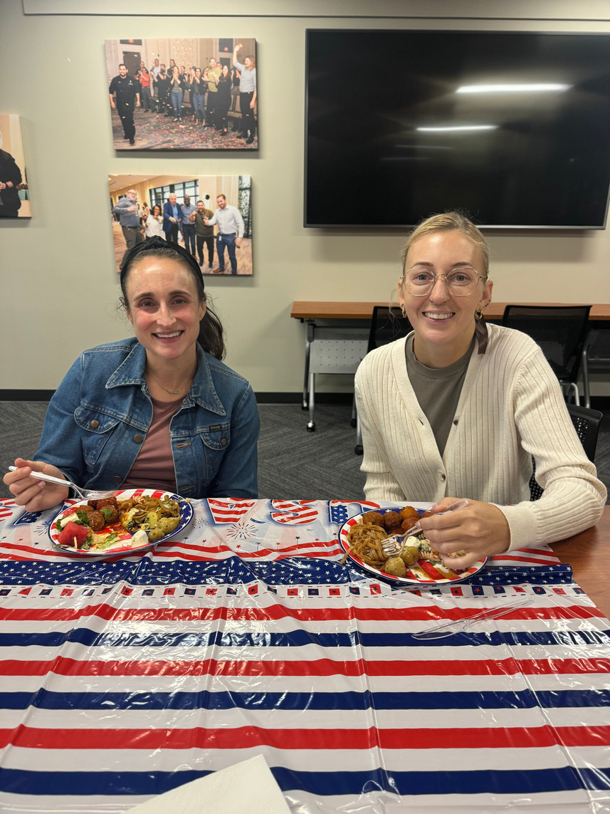
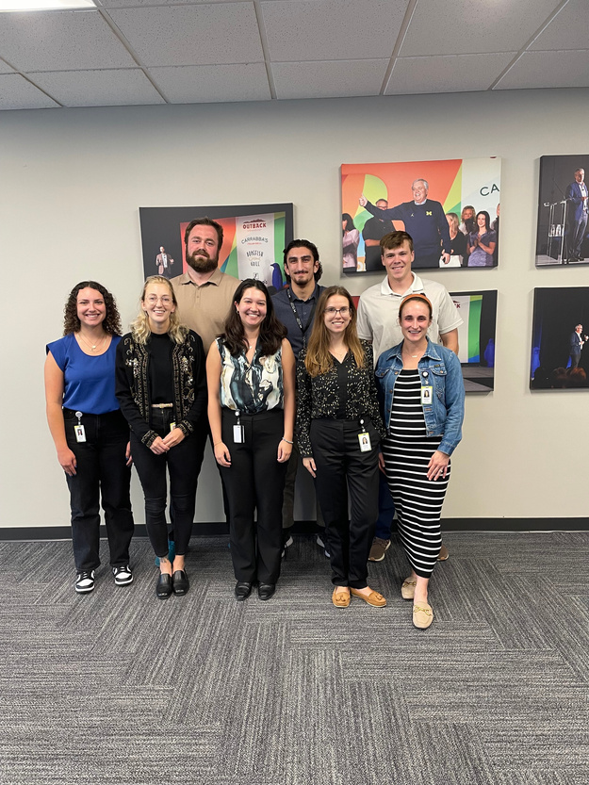
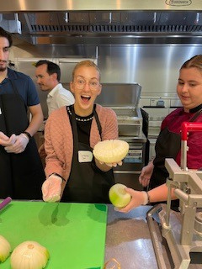
Photo Memories
A fun filled summer of new friendships, hard work, and good food!

Slide 11

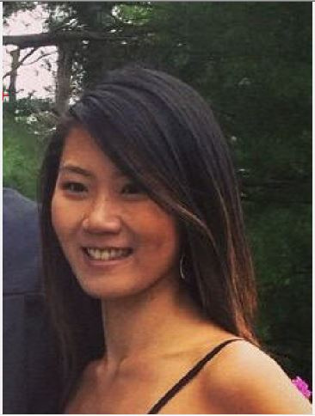
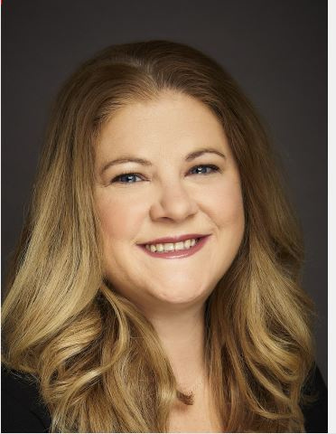
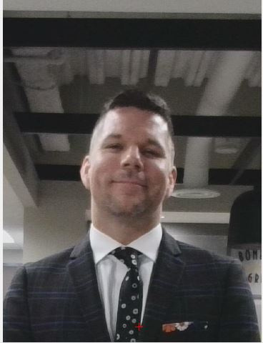
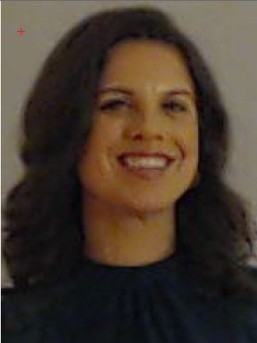
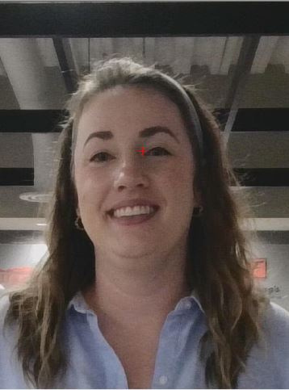
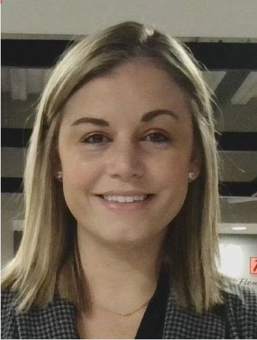
Overall, this experience has been super rewarding and I have truly identified my passion for the field. The culture, people, and food have been nothing short from amazing and every minute has been well spent over the last three months.
Shoutouts:
I would like to extend my gratitude to the B.O.A.T team.

Slide 12

Thank you for listening. I hope you enjoyed it!
Questions?

